Slide 1
Cut-over Plan
CONFIDENTIAL
ERP, APO, BW
2020. 06
S/4HANA Conversion Project TFT

Slide 2
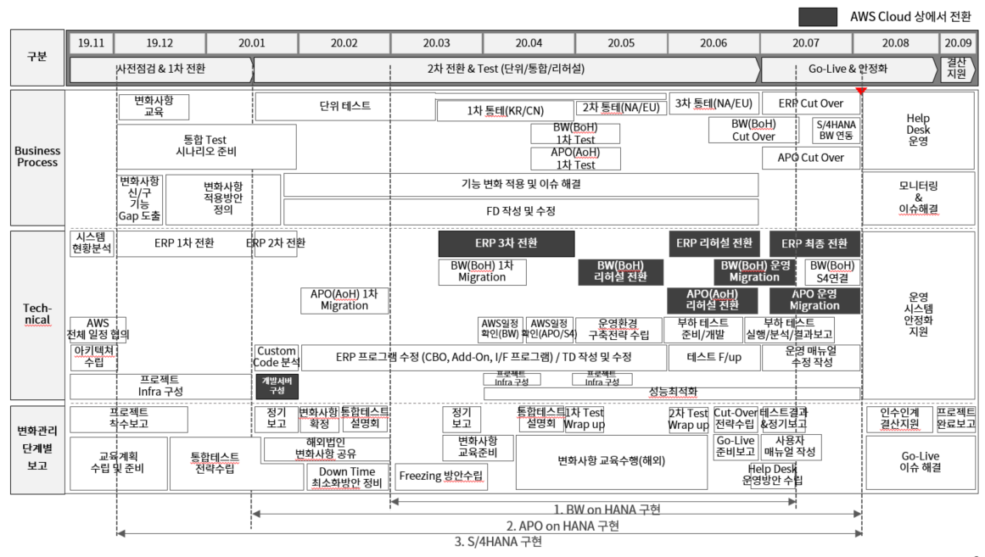
Deploy Phase : D-50
Today, we have about 50 days left until Go-live, and we are in the deployment stage to perform BW, ERP, and APO Cut-over activity after the rehearsal test.
Today
ERP Cut Over
BW Cut Over
APO Cut Over

Slide 3
Agenda
Performance plan
Performing method
Cut-over Task
Conference and communication
R&R by business
Action plans for business partners
Go-live Decision

Slide 4
Cut-over Plan
I. Performance plan
S/4HANA Cut-over is first performed in BW(7/13 - 7/19), and followed by ERP and APO in parallel (7/28 - 8/10). The overall schedule for Cut-over schedule is as follows
S/4HANA Cut-over Overview
BW-Uptime
BW-Downtime
BW-Post Act.
[SUM]Extraction
[SUM]Configuration
[SUM]Check
[SUM]Processing
Developing Object Lock
Request for ERP table backup
[SUM]Execution
Transfer operating system
Application conversion
Modify BW connected RFC
Modify EAI I/F
Check BI Jaba, BO, APO, PORTAL, FOUNDRY connection
Bex Reporting inspection
Process chain
Rescheduling
07/13 – 07/17
07/17 – 07/19
07/19
BW Go-live
(07/19 18:00)
‘20. 07. 06
‘20. 07. 13
‘20. 07. 20
‘20. 07. 27
’20. 08. 03
‘20. 08. 10
BW Cut-over (07/13 ~ 07/19)
ERP, APO Cut-over (07/28 ~ 08/10)
07/06
07/19
07/20
07/31
ERP/APO Go-live
(08/11 00:00)
Freeze developing object
Designate authorization and menu
Oracle DB upgrade (11g → 12g)
3rd CTS Synchronization (GSP → GE1)
Final CTS apply
Unable to modify/reflect developing object
07/28 – 08/07
08/07 – 08/10
08/10
ERP/APO-Uptime
ERP/APO-Downtime
ERP/APO-Post Act.
Confirm plan order
Check logistics closing/completion
Check FI/CO closing/completion
Check completion of cost calculation
Stop batch and block user access
APO SUM (51h)
ERP SUM (50h)
FI/CO migration
Decide Go/Back
Check EAI & Legacy service connection
Fiori service connection
Check BW connection
EAI and Batch re-operation

Slide 5
Cut-over Plan > ERP & APO
I. Performance plan
In particular,ERP, APO Cut-over which influences business downtime is divided into 4 stages :Preparation, Uptime, Downtime, and Post Activity, and is performed for about 13 days. (Excluding the preparation period). About 78 hours of downtime is estimated.
System Downtime 78 hours
Category | Preparation | Uptime | Downtime | Post Activity
 | ‘20. 07. 06 ~ 07. 31 | ‘20. 07. 28 ~ 08. 07 | ‘20. 08. 07 ~ 08. 10 | ‘20. 08. 10
Milestone
ERP
APO
Major procedure | Delete table for Downtime optimization (CBO/STD) Designate authorization and menu Upgrade Oracle DB (10g → 12c) Upgrade SAP Component SI-Check 3rd CTS synchronization (GSP → GE1) Reflect final CTS (GSP, GE1) | SUM Uptime Delete Unused Planning Area Confirm plan order Close settlement for previous month Check FI/CO settlement/closing Check completion of real cost calculation Create/adjust price master creation and adjustment | Stop Batch Job and User Lock Stop EAI & Legacy System service Check CIF Model Intergration Active SUM Downtime Transfer Notes & CTS Check Object/source system CO migration and verification | Transfer developing program Program verification Data verification Check major functions of each module Verify EAI & Legacy system service connection Start process chain Connect Fiori Service Batch Job re-operation and Unlock User
Freeze Developing Object 07/06 (09:00)
Stop ECC system
08/07 (18:00)
Go-live Decision
8/10 (22:00)
Go-live
8/11 (00:00)
Design-ate
authori-zation
&
menu
Oracle
DB
upgrade
3rd CTS synchronization
Reflect final CTS
ERP SUM
(Uptime)
Check FI/CO settlement/completion
ERP SUM
(Down
time)
Transfer Notes
FI/CO
Migration
Transfer Development program and authorization/ menu
Verify EAI / Legacy connection &
All programs
APO SUM
(Uptime)
APO SUM
(Down
time)
Migrationpre-work
EAI re-operation
Batch Job re-operation

Slide 6
Cut-over Major Activity > ERP & APO
I. Performance plan
Preparation
Uptime
Downtime
Post-Act
Go-Live
Person in
charge
Cut-over Task
Schedule
Major inspections
Start freezing developing object (For managing system)
PMO
07/06 09:00 ~
Check Code Freezing notification
Designate authorization and area menu (Transfer from GE1 to 8/10 CTS)
ALL
07/06 ~ 07/24
Check newly registered authorization (BP/MIGO..)
Delete tables for Downtime optmization(CBO/STD)
BC
07/13 ~ 07/27
Table list for deletion (Type/Count)
Upgrade Oracle DB (11g → 12c)
BC
07/19 00:00 ~ 04:00
-
Upgrade SAP Component (SAP_BASIS, SAP_BW)
BC
07/19 04:30 ~ 09:00
-
3rd CTS synchronization (GSP → GE1)
ALL
07/20 18:00 ~ 19:00
List for 3rd CTS synchronization (Sample inspection)
Execute SI-CHECK program
BC
07/23 ~ 07/24
SI-Check result list (Check the reflection)
Check total amount of depreciation for DISA / lease assets class Customizing
FI
07/25 09:00 ~ 18:00
-
Reflect final CTS (GSP, GE1)
ALL
07/31 14:00 ~ 15:30
List for 3rd CTS synchronization (Sample inspection)
Unable to modify/reflect developing object (Code freezing)
BC
07/31 16:00 ~
-

Slide 7
Cut-over Major Activity > ERP & APO
I. Performance plan
Preparation
Uptime
Downtime
Post-Act
Go-Live
Person in
charge
Cut-over Task
Schedule
Major inspections
ERP SUM(Uptime)
BC
07/28 ~ 08/07
-
[운영 적용] Delete unused Planning Area
APO
07/24 17:00 ~ 18:00
Check of 운영 work proceed
Confirm plan order (PP/DS using plant)
APO
07/27 ~ 08/05
Check for remaining planning order
APO SUM(Uptime)
BC
07/29 ~ 08/07
-
Check Logistics closing/completion
SCM
~ 08/03 18:00
Check for closing by person in charge
Check FI/CO , cost closing/completion
FCM
~ 08/07 18:00
Check for closing by person in charge
Adjust Commitment Item Category
CO
08/07 15:30 ~ 16:00
-
Create Cost Element
ALL
08/07 16:00 ~ 16:30
-

Slide 8
Cut-over Major Activity > ERP & APO
I. Performance plan
Preparation
Uptime
Downtime
Post-Act
Go-Live
Person in
charge
Cut-over Task
Schedule
Major inspections
Stop ECC system, stop Batch Job and block users (Deactivate DOOINS accessing menu)
BC
08/07 18:00 ~ 19:00
Check if managing system stopped
Stop EAI & Legacy System service
Legacy
08/07 18:00 ~ 19:10
-
APO SUM(Downtime) start ~ end
BC
08/07 18:00 ~ 08/09 21:00
-
ERP SUM(Downtime) start ~ end
BC
08/07 18:00 ~ 08/09 20 :00
-
Pre-works for FI/CO Migration
FI, CO
08/09 20:00 ~ 21:00
-
Check CIF Model Integration Active
APO
08/09 20:00 ~ 20:30
Check of Activation (T-Code : CFM2)
CIF Variant version upgrade
APO
08/09 20:30 ~ 21:00
Check of Variant appliance(T-Code : CFM1)
CCR Delta Report Connection
APO
08/09 20:00 ~ 21:00
Check of execution (Execute the program)
Fi/CO Migration start ~ end
PMO
08/09 21:00 ~ 08/10 15:00
-

Slide 9
Cut-over Major Activity > ERP & APO
I. Performance plan
Preparation
Uptime
Downtime
Post-Act
Go-Live
Person in
charge
Cut-over Task
Schedule
Major inspections
Apply ERP related CTS (GE1 → GSP)
ALL
08/10 15:00 ~ 17:00
-
Check authorization and menu
ALL
08/10 17:00 ~ 18:00
-
ECC vs S/4HANA Data verification
ALL
08/10 18:00 ~ 20:00
Check for data check list
Send BW related CTS (GE1 → GSP)
BC
08/10 18:00 ~ 18:30
Check for changes in ERP
DMS setting: Add DC30 extension and release authorization group
BC
08/10 19:00 ~ 22:00
-
MASTERSAF Import
BC
08/10 19:00 ~ 22:00
-
Encryption (SPIN) Import
BC
08/10 19:00 ~ 22:00
Check for encryption table inquiry
Reboot Batch Job
BC
08/10 20:00 ~ 22:00
Check Batch Job List
Check for S/4HANA connection settings(S/4HANA <-> BW)
BW
08/10 19:00 ~ 19:30
-
BW - CTS transfer(BPD → BPP)
BW
08/10 19:30 ~ 20:00
Check for changes in BW

Slide 10
Cut-over Major Activity > ERP & APO
I. Performance plan
Preparation
Uptime
Downtime
Post-Act
Go-Live
Person in
charge
Cut-over Task
Schedule
Major inspections
Take action on Pegging Area error(특성 재 CIF)
APO
08/10 16:00 ~ 17:00
Check by specific class table inquiry
Check major functions of each module and process manual
APO
08/10 21:00 ~ 21:30
Check list of each module inspection
Connect EAI S/4 HANA
EAI
08/10 18:00 ~ 20:00
List of inspection for each EAI system(Inquiry screen)
Activate SAP accessing menu of DOOINS portal
Legacy
08/10 18:00 ~ 19:00
Check for system connection
Verify EAI & Legacy System service connection
Legacy
08/10 18:00 ~ 20:00
Check for system connection list
Fiori - Front system interface: 운영(GSP)
BC
08/10 18:00 ~ 19:00
Check if Fiori works well (Check screen)
Interface test with DOOINS,SSO,EP
BC
08/10 19:00 ~ 20:00
Check system connection
Check of legacy system connection
Legacy
08/10 20:00 ~ 22:00
Check list of Legacy & 3RD Party
Check major functions of each module
ALL
08/10 19:00 ~ 22:00
Check system checklist
S/4HANA Conversion Go/Back decision
PMO
08/10 22:00 ~
Check the final list of system conversion inspection

Slide 11
Cut-over Major Activity > ERP & APO
I. Performance plan
Preparation
Uptime
Downtime
Post-Act
Go-Live
Person in
charge
Cut-over Task
Schedule
Major inspections
S/4HANA Go-live
PMO
08/11 00:00
System open notification
Execute Transaction CCR
APO
08/10 22:00 ~ 08/11 02:00
Check the error after the execution and take action
Recreate plan order
APO
08/11 02:00 ~ 05:00
Check the error after the execution and take action
Re-execute MRP
APO
08/11 05:00 ~ 06:00
Check the error after the execution and take action

Slide 12
Cut-over Plan > Code Freezing & Downtime
I. Performance plan
32 hours of BW, and 78 hours of ERP/APO system downtime is necessary for S/4HANA conversion cut-over activity.
Code Freezing Period
System
Corp.
Time-zone
Applying date
Details
Remark
ECC /APO | Korea | UTC+9 | 7/6 (Thurs) | 09:00 | Start freezing developing object | Allow immediate modification of closings and legal issues
 |  |  | 7/31 (Fri) | 16:00 | Lock developing object | Unable to develop/transfer ABAP or CTS
System Downtime Period
System
Corp.
Time-zone
System Downtime
Remark
BW | Korea | UTC+9 | 2020/07/17 (Fri) 19:00 | ~ | 2020/07/19 (Sun) 01:00 | Go-live (7/19, 18:00)
ERP / APO | Korea | UTC+9 | 2020/08/07 (Fri) (18:00) | ~ | 2020/08/11 (Tues) 00:00 | Go-live (8/11, 00:00)
 | China | UTC+8 | 2020/08/07 (Fri) (17:00) | ~ | 2020/08/10 (Mon) 23:00
 | Europe | UTC+2 | 2020/08/07 (Fri) (11:00) | ~ | 2020/08/10 (Mon) 17:00
 | North America | UTC-4 | 2020/08/07 (Fri) (05:00) | ~ | 2020/08/10 (Mon) 11:00
 | South America | UTC-3 | 2020/08/07 (Fri) (06:00) | ~ | 2020/08/10 (Mon) 12:00
(Downtime is based on local time)

Slide 13
[Backup] Downtime Task > ECC & APO
I. Performance plan
Cut-over in ERP and APO areas are performed in parallel from 8/7 to 8/10 and the following are the key actions and schedules for each system within the Downtime period (78 hours).
APO & ERP Cut Over Plan
Go/Back
Decision
S/4HANA Open
8/7(Fri)
8/8(Sat)
8/9(Sun)
8/10(Mon)
20 o’clock
24 o’clock
18 o’clock
21 o’clock
13 o’clock
15 o’clock
22 o’clock
영역별 SPDD 내역 반영
SUM¹⁾ execution (50 hours)
Inspection and performance of
Accounting migration (18 hours)
Migration
Follow-ups (9 hours)
SUM execution preparation
Check closing of previous month
Compare migration data
Stop
Batch Job
Transfer
Notes
Compare
migration
data
ECC Vs S/4HANA
compare
Transfer
developing
program
All program
verification
(SAP,EAI etc.)
Install
Live Cache
SUM execution preparation
Live Cache
Download
Live Cache Upload
Check activation and allocation of Logical System, Integration Model
Start process chain
/Take actions
EAI re-operation
Stop process chain
SUM¹⁾ execution
Transfer
CTS
Inspect
Object/
source system
M/G
DATA verification
Batch Job
re-operation
Stop CIF connection
Change
CIF connection
CIF
test
Load BW Delta
Data
BW
ERP Setting
BW
Data extraction
Reserve Batch Job
Block
groupware menu
Legacy restoration
And inspection
Groupware menu
restoration
Downtime 78시간
¹⁾SUM : Software Update Manager
ECC
HANA
APO
BW
Legacy

Slide 14
[Backup] Downtime Task > BW
I. Performance plan
BW Area Cut-over is performed from 7/17 to 7/19. Key actions and schedules within the Downtime period (47 hours) are as follows.
BW on HANA Cut Over Plan
BW Go-live
7/17(Fri)
7/18(Sat)
7.19(Sun)
7/20(Mon)
12 o’clock
16 o’clock
19 o’clock
20 o’clock
11:00 pm
01:00 am
03:00 am
04:00 pm
06:00 pm
09:00 pm
07 pm
SUM¹⁾ Pre-work
SUM execution (30 hours)
SUM Follow-ups(17 hours)
House Keeping 사전완료
Stop process chain
BW
Object and source system inspection
Bex. BQ
test
Start process chain
BW backup
HANA DB backup
1st
Data
verifica-tion
Data verification data preparation complete
EAI I/F test
Check monitoring
CTS transfer
Batch restart
RFC modification (ERP, APO)
Downtime 47 hours
¹⁾SUM : Software Update Manager

Slide 15
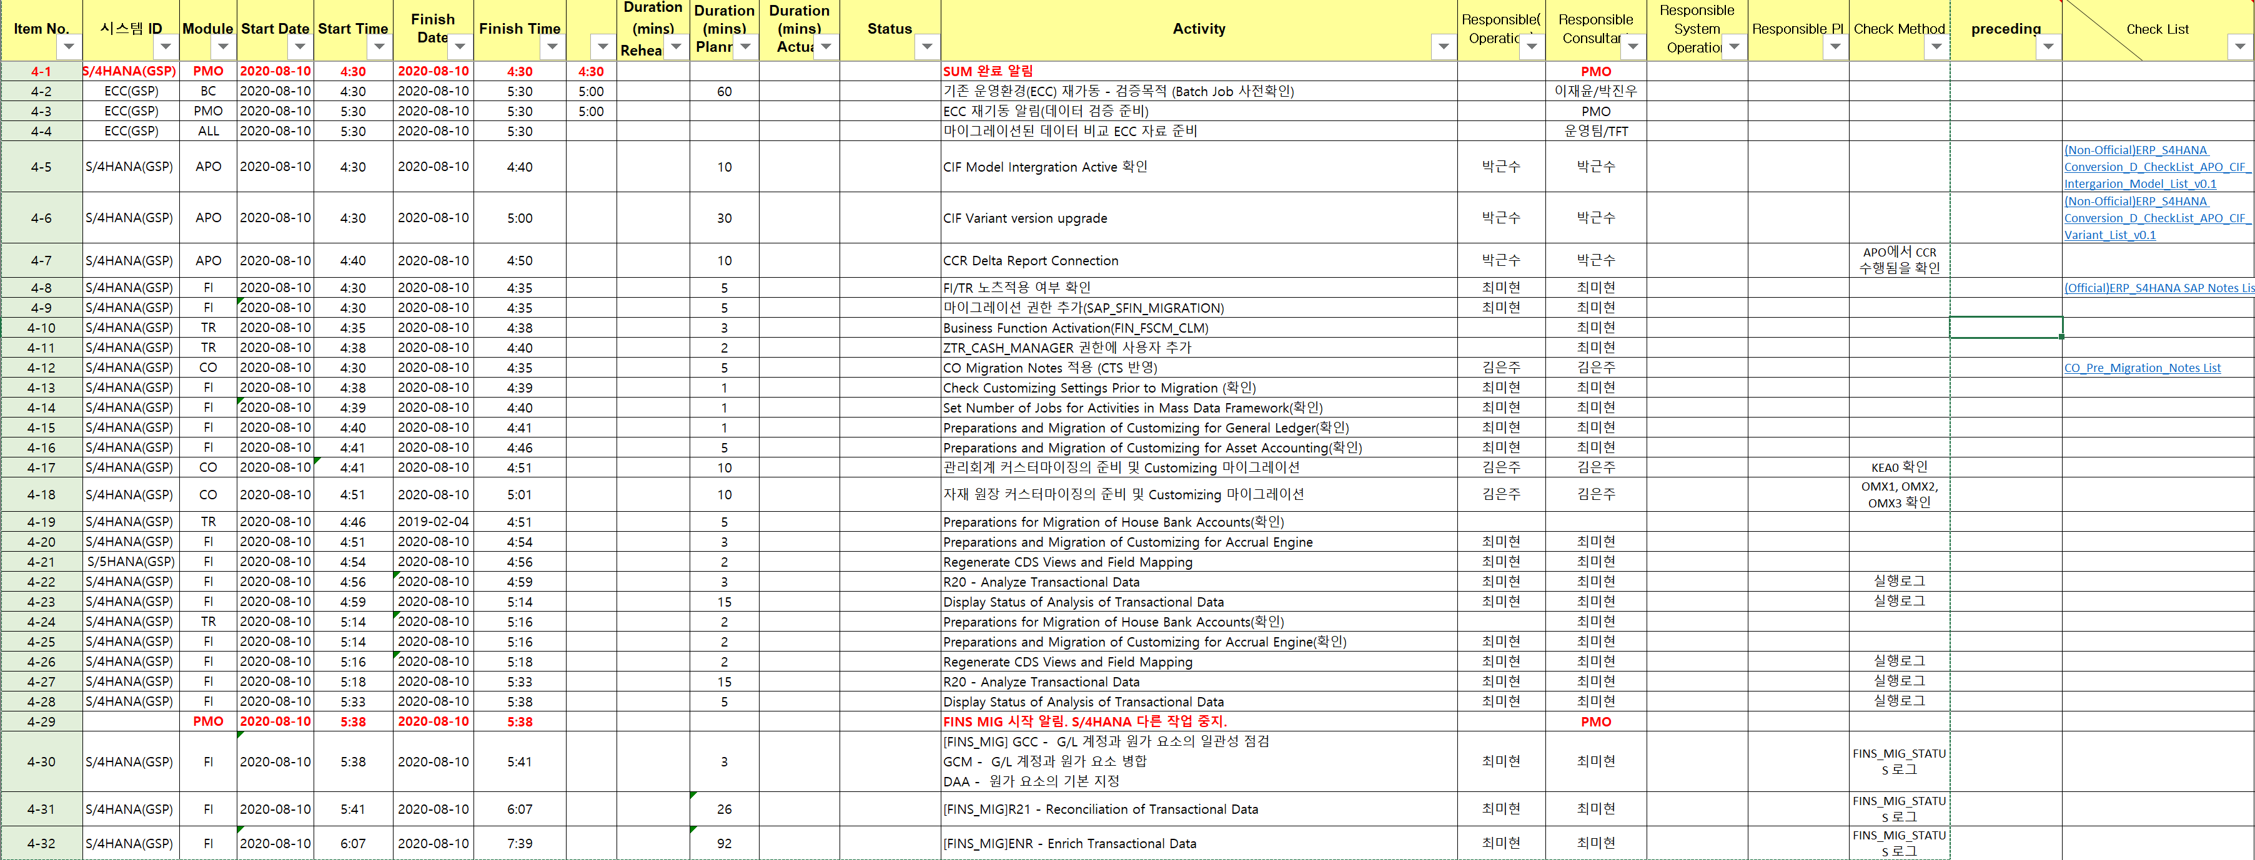
Cut-over Detailed Activity and Check List
II. Performing method
Cut-over activity is shared with PMOs and staff members by checking progress by item and time, and in case of major activities, a separate check list is utilized to ensure that there is no missing task when performing Cut-over.
Cut-over Activity (ERP/APO)
Selective
Record the actual performance time
and progress by activity
Check List by each major activity
(Separately managed)

Slide 16
Meetings and Communications
II. Performing method
There is no structured reporting for each task in order to focus on the Cut-over during the ERP and APO downtime period. However, regular meetings are held to monitor Cut-over progress, Next progress, and issues.
Communication plan
Meetings
Regular Conference Call
PMO
Participants: PMO, Key persons in each area (Consultants, 3rd Party, etc. )
Key issues : Complete in activity unit, Process next, Share issues and risks
Method: MS Teams meeting
Schedule:
Share the completion of major activities
Report issues/risks
Share the status of major activities
Request for additional work if necessary
Steps
Period | 7/28 ~ 8/7 | 8/7 ~ 8/10 | 8/10 ~ 8/17
Cycle | (If necessary) | Once a day | Once a day
Time | (TBD) | 21:00 (KST) | 21:00 (KST)
Before Downtime
Downtime
After Go-live
Key persons
in each area
Report completion by Task units
Report Issues/risks
Instruct work in Task units
Share work status
Report for finishing Activity and Task
Targets: PMO, Key persons in each area (Consultants, 3rd Party etc), Team members
Details: Report completion by Activity units, Share issues and risks
By : e-mail
Schedule: Occasional (Before/after performing major activity or task)
Team members
※ PMO leads the communication of foreign corporations and merges the Cut-over results.

Slide 17
R&R by business
II. Performing method
To ensure smooth communication and prompt action during Cut-over, especially during Downtime, the PMO and key persons in each area are always on standby to monitor progress and not affect the Go-live schedule.
R&R |  | Targets | 8/7 | 8/8 | 8/9 | 8/10
PMO | Cut-over monitoring and communications Make Decisions for important issues Confirm the final result of cutover | Kim Heeyoung, Kim Sangwook, Lee Bumsuk, Chong Jooyoung, Oh Jiyeon, Kim Jaewon | S | S | S | M
ERP | Preparation for conversion and SI-Check inspection Post activity and subsequent migration for each module Verification of each module’s functions and data | FITR: Choi Mihyeon CO: Kim Eunju PP: Park Jihong SD: Hwang Inseok, Park Minjeong MM: Lim Byungki (*Support of DDI operators) | S | M | M | M
APO | Inspect major functions for each APO module Perform Process Chain manual Inspect LiveCache | Park Keunsoo | M | S | M | S
BC | Execute SUM (ERP, APO) Install AP System Setup and verification (DMS setting etc.) | Lee Jaeyoon, Park Jinwoo | M | M | M | M
Legacy | Verify EAI & Legacy system connection Inspect Local system function (Tavant, GRC etc.) | China: Jang Yeongjin Korea: Son Yeongcheol America: Prashanth / Brian Brazil: Marcelo | M | S | S | M
(M: Main, S: Support / Detailed work plans for each workforce will be posted separately)

Slide 18
[Backup] Phone numbers of the person in charge
II. Performing method
Area |  | Name | E-mail | Phone number
PMO |  | Kim Heeyoung | heeyoung.kim@doosan.com | 010-4631-1735
 |  | Kim Sangwook | sangwook1.kim@doosan.com | 010-5307-9428
 |  | Lee Bumsuk | bumsuk.lee@doosan.com | 010-2788-4939
 |  | Chong Jooyoung | jooyoung.chong@doosan.com | 010-6201-4689
 |  | Oh Jiyeon | jiyeon.oh@doosan.com | 010-8412-0574
ERP | FITR | Chang Sukhee | sukhee.chang@doosan.com | 010-6260-7463
 |  | Choi Mihyun | mihyun1.choi@doosan.com | 010-7108-5360
 | CO | Kim Jooil | jooil.kim@doosan.com | 010-5717-6739
 |  | Kim Eunju | eunju1.kim@doosan.com | 010-8959-7554
 | SD | Hwang Inseok | inseok1.hwang@doosan.com | 010-3211-2234
 |  | Park Minjung | min-jung.park@doosan.com | 010-9046-2567
 | MM | Lim Byungki | byungki.lim@doosan.com | 010-3226-0217
 | PP | Park Jihong | jihong2.park@doosan.com | 010-5247-9012
APO |  | Park Keunsoo | keunsoo2.park@doosan.com | 010-9014-8083
BC |  | Lee Jaeyun | jaeyun.lee@doosan.com | 010-8631-7058
 |  | Park Jinwoo | jinwoo2.park@doosan.com | 010-5266-5226
Legacy | KO | Son Youngchul | youngchul.son@doosan.com | 010-9460-3729
 | CH | Zhang Yongzhen | yongzhen.zhang@doosan.com | -
 | NA | Prashanth Vayilla | prashanth.vayilla@doosan.com | -
 |  | Brian Grellinger | brian.grellinger@doosan.com | -
 | SA | Marcelo Bruno | marcelo.bruno@doosan.com | -

Slide 19
Action Plans for business partners
Major Action Plans of each area
- Request to the PI team to fill in
III. Action Plans for business partners
Notifications and requirements for business partners to prepare for the cut-over and system downtime
Area
Category
Detailed Action Item
Schedule(Due)
Performer
FI | July closing | Clear the differences between the total account ledger, and bond and debt ledger Clear the negative stock, difference between stock and inventory, and 선매출 Establish a plan to clean up the amount of inventory that is not related to the cost receipts and disbursements | 8/7
 | TBU | Secure the service parts beforehand
 |  | Pre-notification to the dealers
APO | Planning order arrangement | Confirm/Complete by Planning order -> Production order | 8/7

Slide 20
Go-live final inspection and decision
IV. Go-live Decision
The implementation of Go-live is based on the results of the Go-live Checklist by predefined Function, Data, Interface, and CTS, and a final inspection meeting is held at 22:00 before the Go-live.
Based on Go-live ¹⁾
Final Go-live Inspection meeting
Downtime goal
Date
And
Place
8/10 (Mon) 22:00 – After the finance migration, transfer post activity
FASTFIVE meeting room(TBD) or online
Complete Go-live within 72 hours of downtime
Check CTS application
Check the test performance of the display screens after applying the final development server CTS.
In case of major registration/modification program, proceed transfer source eye check (Based on recent changes).
Attendees
PMO & PI
Person in charge of BC
Person in charge of each module
System Interface
Agenda
Check inspection results for Go-Live and any further issues
Result of BC’s System Copy and Post Job work result (Appliance of final transferred CTS etc.)
Result of each module’s CTS application and the interface inspection
Check the succession of I/F with the Legacy & 3RD Party solution (Display Only)
Check any abnormalities of major systems such as EAI, EDI, EP,APO, BW, and SSO.
Data Verification
There is no problem with key data verification results by module compared to existing ECC. (Data count & Report verification)
※ At that point, when the final decision cannot be made,
Before Go-live, check the possibility of final action
Proceed Go-live or Contingency Plan
1) Go/Back decision Check list is managed in the separate Excel file

Slide 21

Contingency Plan
IV. Go-live Decision
If the Go-live inspection results in severe Downtime delays or Critical problems that cannot be immediately taken, Contingency Plan is activated to rollback to the ECC.
Result of Go-live Decision
Contingency Plan (Rollback)
Result of final review |  | Decision
Case 1 | No system abnormality No error in the data or function | Open
Case 2 | System Downtime Delay (Check the time required by section) | Review on the final downtime and decide
Case 3 | Critical issue occurrence (Data, Function, I/F, etc.) | Determine if immediate action is possible
Required time
Within 2 hours after the decision (There is no changes in the ECC, so it can be quickly restored by backup)
Rollback
System: ERP, APO, BW, Legacy system
I/F: EAI, RFC etc.
Check list of normal completion
I/F verification of functions and systems
Data verification
Suji DC
AWS
ECC/APO/BW
Go (Case 1)
S/4HANA
Go (Case 1)
System
Operation
Stopped
Downtime
conversion
Infra inspection
and
final inspection
Go-live
As-Is operating system
To-Be operating system
Go/Back
Backup
Rollback (Case 2, Case 3)
Go (Case 2, Case 3)

Slide 22
End of Document

